Slide 1
Analysis Report
Workplace Satisfaction Survey dataset
Group-10

Slide 2
Background of the survey
Interviewed by 82 employees to measure satisfaction with management, colleagues, working environment, salary, and tasks
The dataset used for this analysis was collected through an workplace satisfaction survey.
The collected responses help in analyzing patterns, trends, and correlations between variables such as job role, years of experience, gender, and satisfaction levels.
This data provides a comprehensive view of how employees perceive their workplace.

Slide 3
Variables of the survey
No. | Variable | Type | Description
1 | number | Identifier | Unique ID for each respondent
2 | gender | Categorical | 1 = Male, 2 = Female
3 | age | Numerical | Age in years
4 | family | Categorical | 1 = Single, 2 = Not single
5 | education | Categorical | 1 = Primary, 2 = Secondary, 3 = Bachelor, 4 = Master
6 | years_of_service | Numerical | Number of years working in the company
7 | palkka (salary) | Numerical | Monthly salary in euros (€)
8 | sat_management | Likert Scale | Satisfaction with management (1–5; 1=Very unsatisfied, 5=Very satisfied)
9 | sat_colleques | Likert Scale | Satisfaction with colleagues (1–5)
10 | sat_workEnvironment | Likert Scale | Satisfaction with work environment (1–5)
11 | sat_salary | Likert Scale | Satisfaction with salary (1–5)
12 | sat_tasks | Likert Scale | Satisfaction with job tasks (1–5)
13 | healtCare | Categorical | 1 = Used company healthcare
14 | holidayCabin | Categorical | 1 = Used company holiday cottage
15 | gym | Categorical | 1 = Used company gym
16 | muscleCare | Categorical | 1 = Used massage service (company pays half)
The dataset includes both background variables (employee characteristics) and main interest variables (opinions and satisfaction).
Total of 16 variables describing personal, professional, and satisfaction-related factors.
Data is analyzed to understand what factors influence workplace satisfaction.

Slide 4
Background analysis (variable by variable)

Slide 5
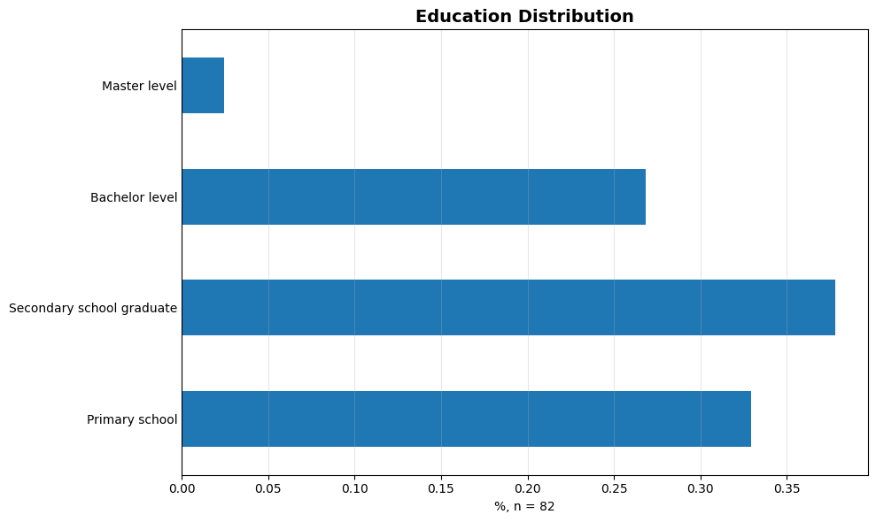
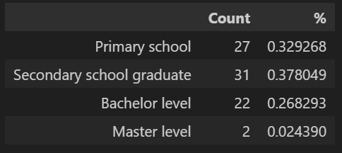
Background analysis (Education variable)
1 = Primary, 2 = Secondary, 3 = Bachelor, 4 = Master
1. We wanted to know How many people belong to each education category.
2. Our analysis: Most respondents hold a secondary or primary school education.

Slide 6
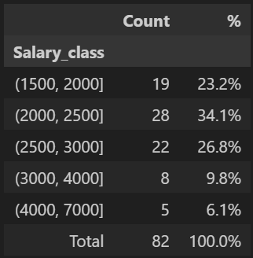
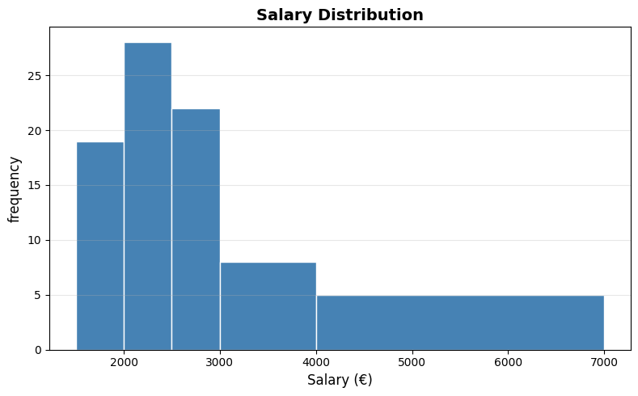
Background analysis (Salary variable)
This variable represents continuous numerical data of salaries suitable for binning and distribution analysis.
We can see that maximum number of salary of 28 peoples are 34.1%.

Slide 7
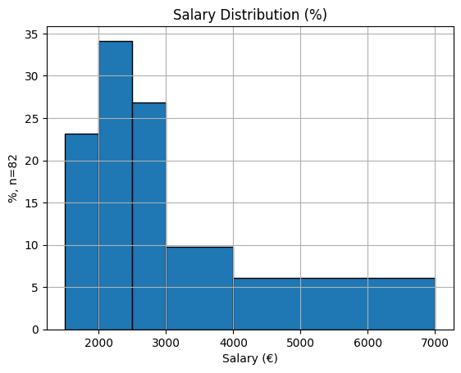
Background analysis (Salary variable) extended
Since boxplot does not describe the employee salary fully in the histogram of that variable so we have created bins/ranges to categorize the salary data.
The salary_class bins are defined like:
1500-2000
2000 – 2500
2500 – 3000
3000 – 4000
4000 – 7000
The bar graph validates percentage and shows overall scale of salary to showcase the salary distribution.

Slide 8
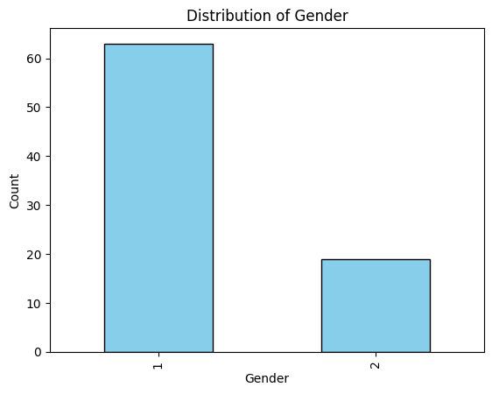
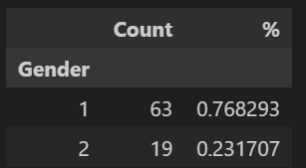
Background analysis (Gender variable)
Based on the survey the gender of employees are distributed by count and gender.
This bar chart visualizes the gender distribution within the sample population, totaling 82 individuals. The data reveals a significant skew, with males representing the majority of 77%, while females constitute a minority of 23%.

Slide 9

Background analysis (more ….)

Slide 10
Analyzes two qualitative variables
Examined the relationship between age and salary using a scatter plot, showing a clear positive trend - salaries generally rise with age and experience.
Investigated the link between years of service and salary satisfaction, revealing that longer-serving employees are usually less satisfied with their pay
Analyzed relationship between gender and education, found men are more likely to have higher education levels, while women are more concentrated in lower education categories.
Examined the relationship between years of service and different satisfaction factors to show actual satisfaction levels.

Slide 11
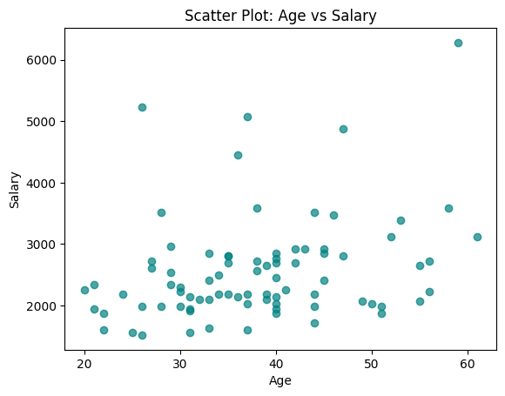
Analyzing relationship between age & salary
The figure here shows the relationship between two numerical variables.
The scatter plot is given in the right.
The graph reveals a moderate positive correlation, indicating a general tendency for salary to increase as age increases. This is consistent with the expectation that individuals gain experience and advance in their careers over time.
The data points begin clustered in the lower-left quadrant (younger individuals with lower salaries) and trend towards the upper-right quadrant (older individuals with higher salaries). However, the spread of the data is significant, meaning that at any given age, there is a wide range of salaries. For instance, some 40-year-olds may earn similarly to some 50-year-olds.

Slide 12
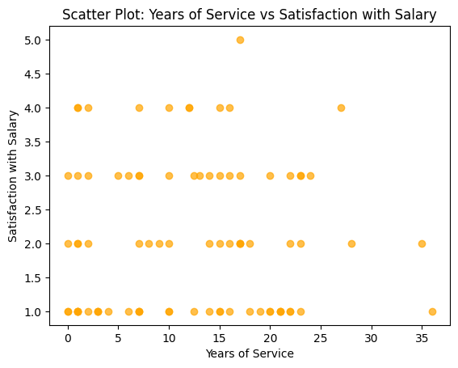
Analyzing relationship Years of Service vs Satisfaction with Salary
This scatter plot investigates the relationship between employee tenure and pay satisfaction. The graph reveals a moderate negative correlation, indicating a general tendency for salary satisfaction to decrease as an employee's years of service increase.
New employees (0-5 years of service) show a wide range of satisfaction but are clustered in the higher end of the scale (4-5). In contrast, employees with longer tenure (20+ years) are consistently clustered in the lower end of the satisfaction scale (1-2).
This pattern strongly suggests an issue with internal salary equity and career progression. It is likely that the company's strategy of hiring new talent at competitive market rates is not being matched by equivalent salary growth for existing employees.

Slide 13
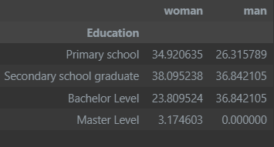
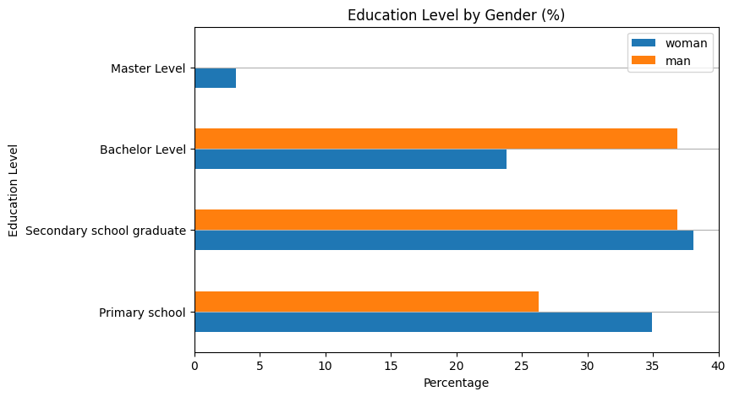
Analyzing dependency between variables (gender and education)
Women have the highest proportion of individuals with only a primary school education (34.9% vs. 26.3% for men).
Men have a significantly higher proportion of individuals with a bachelor's degree (36.8% vs. 23.8% for women). The proportion of men and women with a secondary school education is relatively similar.
In summary: In this graph, men are more likely to have a bachelor's degree, while women are more likely to have only a primary school education or the highest (master's) level of education.

Slide 14
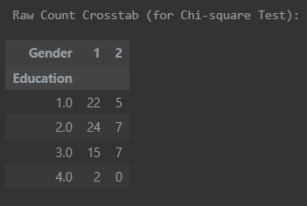
Performing a Chi-square Test of Independence: Gender and Education
By performing the "Chi-square Test of Independence", we can check if the differences observed in the crosstab (Education × Gender) are likely due to chance or reflect a genuine pattern in the data.
If the p-value < 0.05, it indicates a statistically significant relationship — suggesting that education level varies by gender among employees.
If the p-value ≥ 0.05, it means there is no strong evidence of a relationship, implying that education levels are fairly similar across genders in this dataset.

Slide 15
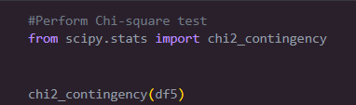
Observational Statement
Based on the p-value of approximately 0.602 from our result, the observation is:
The p-value is greater than or equal to 0.05, which means there is no strong evidence of a relationship between gender and education level in this dataset. This implies that the observed differences in education levels between men and women are not statistically significant and could be due to random chance.

